Slide 1

SA Presentations
By Carson, Kevin, Logan, Matthew Neel, Tracy Rountree

Slide 2
Systems Analysis Presentations
What are they?
A demonstration of your plan for your project’s game
When are they?
February 14th

Slide 3
Requirements
RFP (group)
Champion Document (individual)
Presentation (group)

Slide 4
What is Storyboarding?
A storyboard consists of an array of image panels with accompanying text
A way of visualizing key points in your game
Images/scenes are visualized in sequential order to convey the flow of the game
A storyboard should simply convey the following:
What characters are in the frame and how are they moving?
What is the dialogue of the scene?
The position of the camera
Any other critical information that is necessary to the flow
Notes:
LOGAN

Slide 5
Why Storyboard?
By storyboarding, you are outlining a direction for your project
You will be able to spot issues and brainstorm fixes before you’ve invested real time
Since little technical knowledge is required, it’s easy to get opinions and collaborate with others

Slide 6
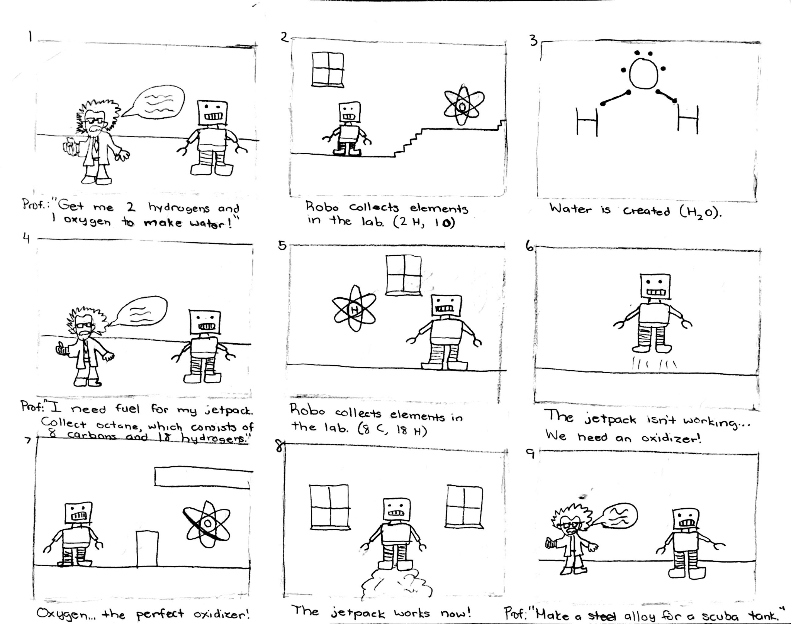
Example Storyboard
https://sites.google.com/site/videogamedesigntsanh/home/storyboard

Slide 7
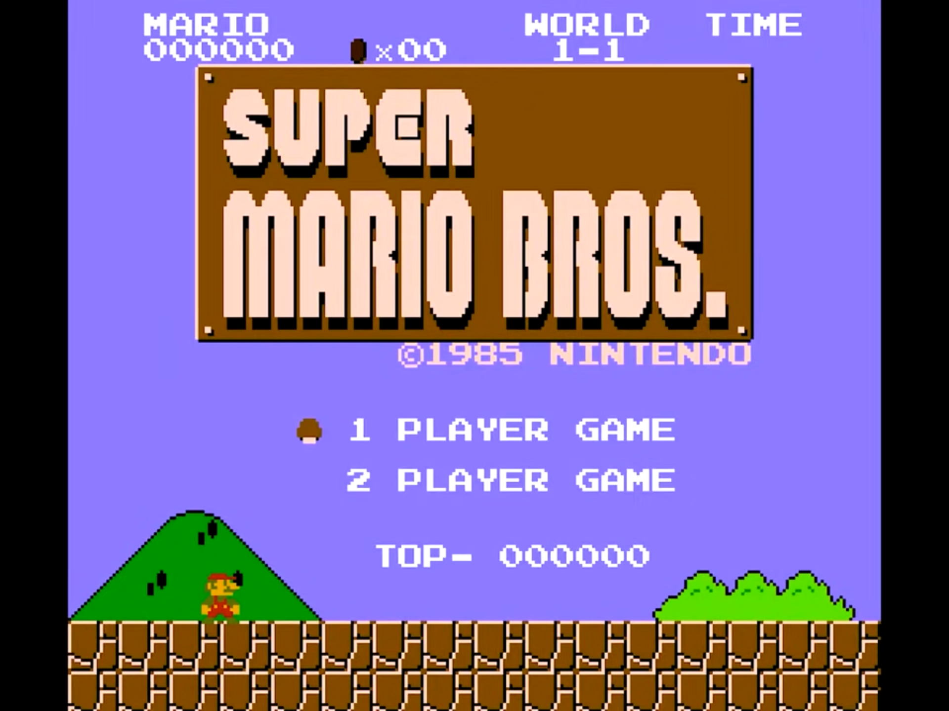
Super Mario Example
Dialogue:
Action:
User can select between 1 and 2 player mode
Notes:
No music playing

Slide 8
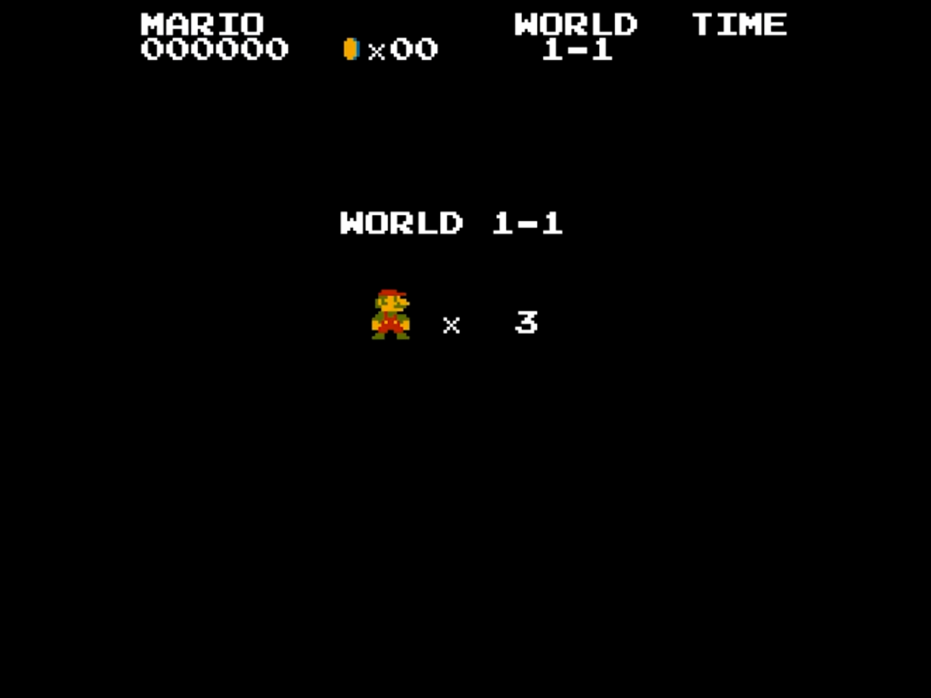
Super Mario Example
Dialogue:
Action:
Notes:
Display important information to the player

Slide 9
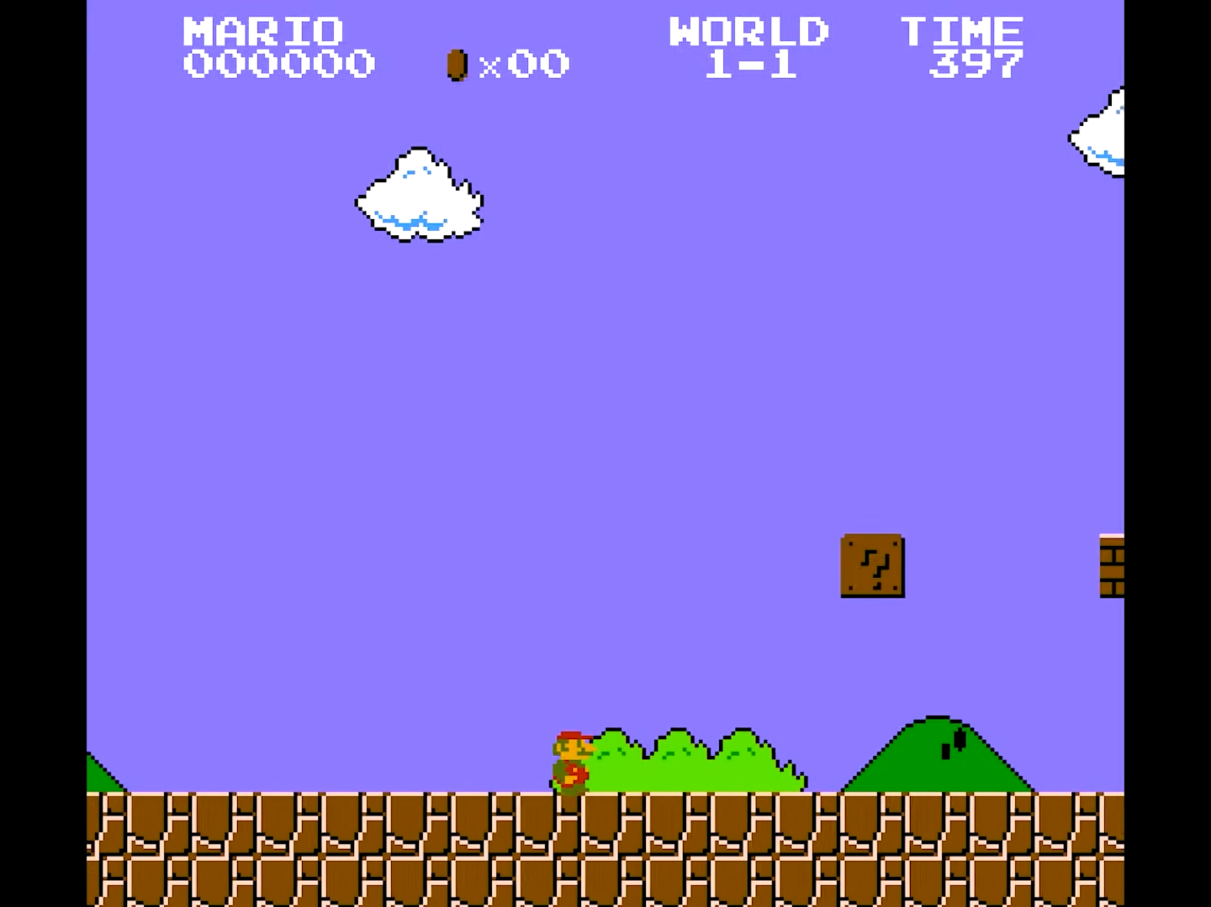
Super Mario Example
Dialogue:
Action:
Player is able to move the character to the right
Notes:
(SFX) Overworld music begins to play
Time begins to count down

Slide 10
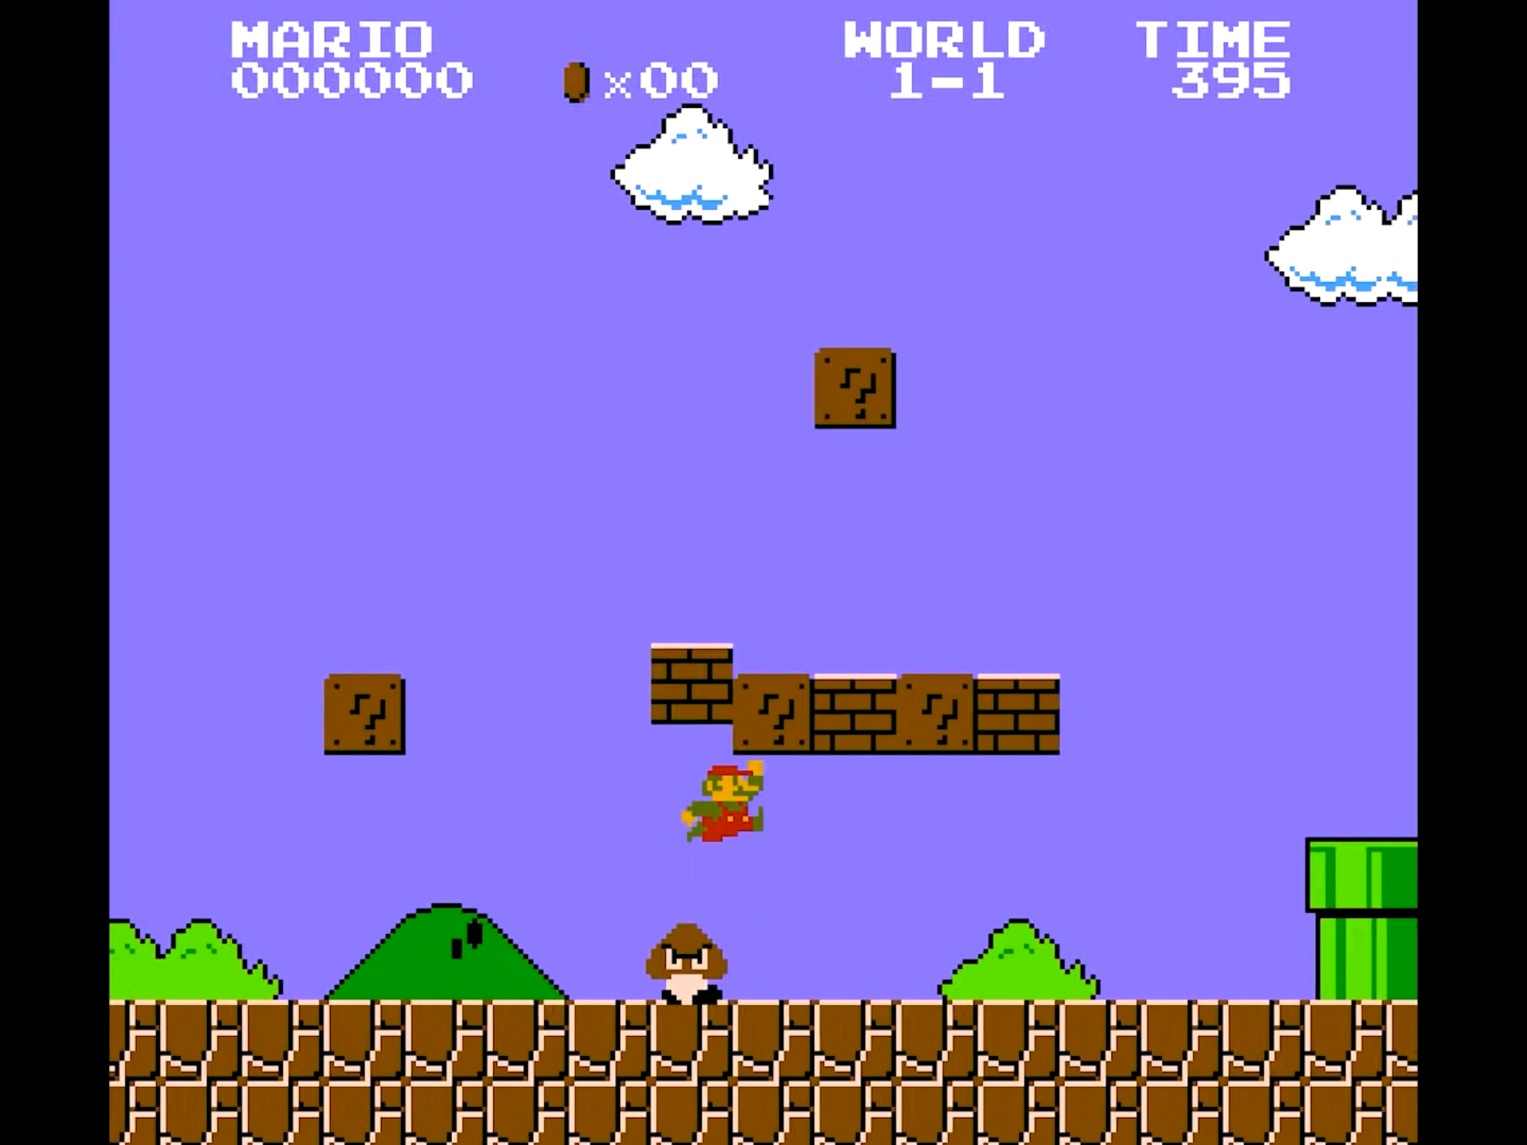
Super Mario Example
Dialogue:
Action:
Player jumps to interact with the block and avoid the goomba
Notes:
(SFX) Block-hit sound plays

Slide 11
Get Good at Git
By Carson, Kevin, Logan, Matthew, Tracy Rountree

Slide 12
Why You Need Version Control
Have you ever broken a project and had to spend hours reading through code to find where things went wrong?
Have you ever wanted to work collaboratively with others on a project without screwing around?

Slide 13

What is Git?
Popular Revision Control Software.
Created by Linus Torvald in 2005.
Allows for multiple people to work on the same project without worry.
Nearly every operation is local.
Offline work is much easier with Git than other RCS systems.
Notes:
Git was an open source tool created by Linus Torvald in 2005. It allowed for linux developers to collaborate on projects at the same time. Unlike other Version Control softwares at the time, Git features branches. Creating a new branch in a project allows users to add and tinker with features without messing with the current working version of a project. Once the branch has been finished, it then can be merged with the main branch once again. Because Git downloads the whole directory, all work can be done offline and pushed back to the repo when you are done.

Slide 14

What is Github?
Git is not Github
Github is a cloud-based hosting platform for Git repositories
Github is owned by Microsoft
Popular alternatives to Github include:
Bitbucket
GitLab
Self-hosted
We have chosen to use Github in our demonstration later on in this presentation
Notes:
Git and Github are not the same program. Git is an open source source platform whereas Github is an cloud based platform to manage git repositories. It allows users to create accounts, share repositories and change who can see or edit any repository hosted on Github. While github is the most popular online hosting platform for Git it is farm from the only 1. Other services include Bitbucket created by Atlassian, GitLab and hosting your own file server for storing and sharing repositories.

Slide 15

How To Use Git
Four popular methods:
Command line
Web client
Desktop application
Text-Editor/IDE integration
We will later demonstrate how to use Git through VSCode

Slide 16
Basic Git Terminology
Version
Shows the current version of Git installed.
Init:
In order to use Git, you first need to initialize Git within your directory
Creates a “.git” folder which stores data about your project
Commit:
Commits message to repository
Includes brief description for other users
Clone:
To clone a repository is to copy it from a remote address to your local machine
Status:
Shows all commits on the current branch.

Slide 17
Git Terminology Cont.
Add:
Git will not automatically track changes to files. You need to directly add files to the Staging Area whenever you create or modify files
Staging Area:
A preview of your next commit. Staged
Revert
git revert <commit>
Go back (revert) to a previous version
“Undo” a commit, in this class, used primarily by TL 1
Remote
git remote add origin <url>
Used to help set up git with a server
Popular examples: GitHub, GitLab, etc.

Slide 18
Git Terminology Cont.
Stash
git stash
Nifty feature to save half-done work when you aren’t ready to commit
Useful if you need to go to do quick work on a different branch, or quickly revert to a working state
Branches
git branch <branch-name>
Create a new line of development
Do work on a different branch, and merge when you’re ready
In this class, mainly used by TL 6
Merge
git merge <commit>
Join two or more development histories together
git rebase works similarly but the way the commit history is kept is different
The way to squish two (or more) branches together into one
What happens if we work on both branches at the same time?

Slide 19
Git Terminology Cont.
Divergent Branches
A feature of git that allows you to do work on multiple branches at once
Sometimes very easy to merge, “fast-forward”
Sometimes not so much
Merge Conflicts
The same part of file has been modified in different ways on two branches
Generally have to simply choose what version you want to keep

Slide 20
Don’t Ignore .gitignore
Some files don’t need to be included in your Git repo
Build files (*.o, etc…)
Cache files
.gitignore templates can be found online
Don’t be afraid to add to your .gitignore if the template doesn’t cover your project’s needs

Slide 21
Live Demo

Slide 22
Git Best Practices
You should ideally never git push --force
Each commit should have changes that are related
A function that prints a name is not related to a function that reads a file into memory (probably) and shouldn’t be included in the same commit
Make small incremental commits
Reduces the opportunity for merge conflicts to arise
If something breaks, it’s much easier to identify where things went awry
Write descriptive commit messages
Poor example: “Fixed bug”
Good example: “Fixed issue where camera didn’t reset on player respawn”
Have a consistent commit message style e.g.
Capitalize the first letter of the message
Start with a verb

